Slide 1
MATHEMATICS PROJECT

Slide 2
Abstract :
Implementation of compound logical proposition equivalences using python in jupyter environment

Slide 3
What is logic?
A science that deals with the principles and criteria of validity of inference and demonstration
In simple way a proper or reasonable way of thinking about something
It helps us to understand reasoning behind issues which could be applied in other issues as well

Slide 4
Laws of logic
Laws of logic are the Basic laws of Propositional Logic
Fundamentally there are three laws of logic
the law of contradiction : not( a and not a)
the principle of identity : a is a
the law of excluded middle : either “a” or not “a”

Slide 5
Applications of laws of logic
Translating English Sentences into logical statements
Logical Puzzles : They can be used for brain exercises, recreational purposes, and for testing a person’s reasoning capabilities
Logic/Computer Circuits
Artificial Intelligence – Fuzzy Logic : in fuzzy logic, there is an intermediate value too present which is partially true and partially false.
Inference and Decision Making
System Specifications

Slide 6
PRODLEM DEFINITION :
For any propositions p , q and r using laws of logic prove the following
~[P or Q or R ] = ~P ^ ~Q ^ ~R
~[P ^ Q ^ R ] = ~P or ~Q or ~R
Write a program to construct the truth table for the above questions

Slide 7
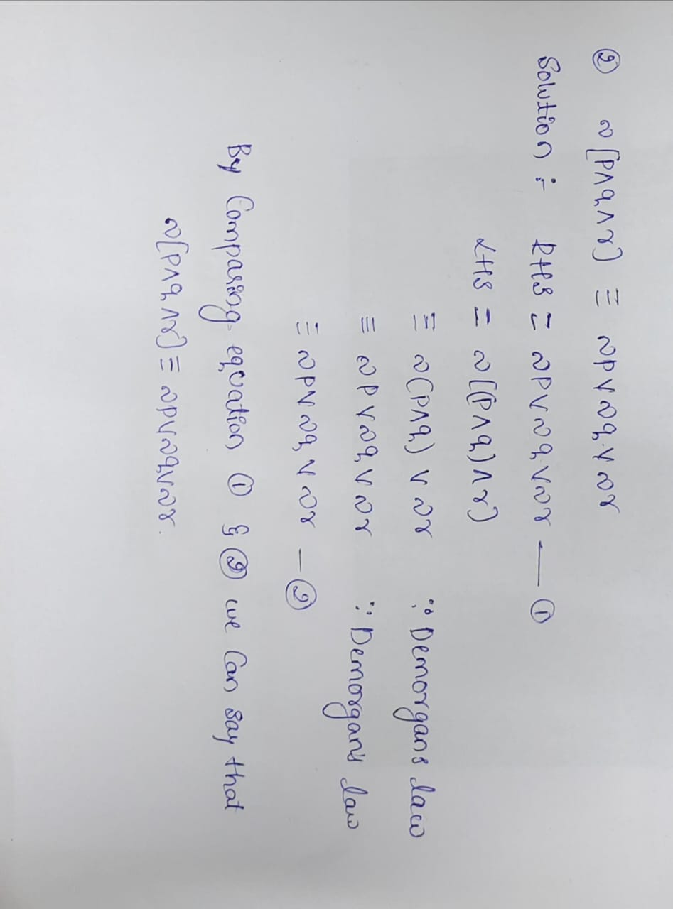
PROBLEM 1)

Slide 8
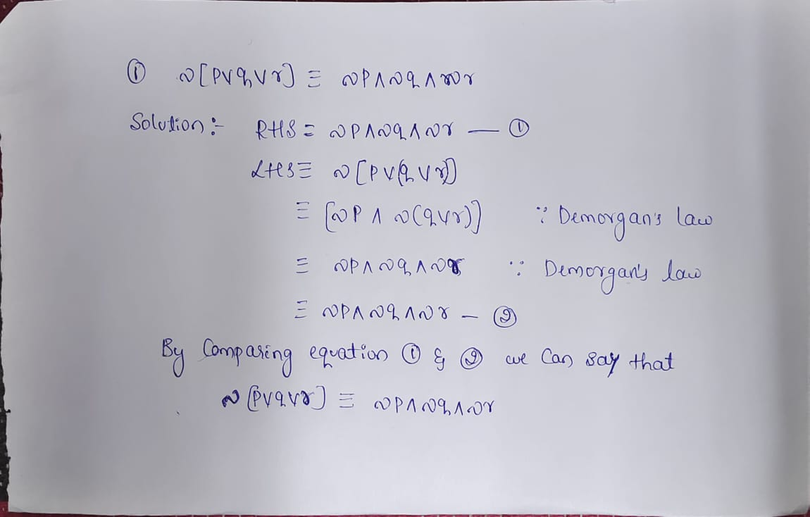
2)

Slide 9
B) PROGRAM SOURCE CODE to generate user input
A )def not__(x):
if x==0:
return 1
elif x==1:
return 0
def main():
print("-:WELCOME:-")
choice="y"
print("1) ~(p ^ q ^ r) \t2) ~p or ~q or ~r\t3) ~(p or q or r)\t4) ~p ^ ~q ^ ~r")
while choice.lower()=="y":
a,b,c=map(int,input("Enter the values of a seperated by space :- ").split())
opt=int(input("Enter the option you want to perform :- "))

Slide 10
if opt==1:
x=a & b & c
print(not__(x))
elif opt==2:
print(not__(a) | not__(b) | not__(c))
elif opt==3:
y=a | b | c
print(not__(y))
elif opt==4:
print(not__(a) & not__(b) & not__(c))
else :
print("Invalid option!.. try again..")
choice=input("Enter 'y' if you want to do it again, else enter any alphabet :- ")
if __name__=="__main__":
main()

Slide 11
Program to generate truth table of given equation:
import ttg
print(ttg.Truths(['p','q','r'],['~(p or q or r)','(~p) and (~q) and (~r)’]))
print(ttg.Truths(['p','q','r'],['~(p and q and r)','(~p) or (~q) or (~r)']))

Slide 12
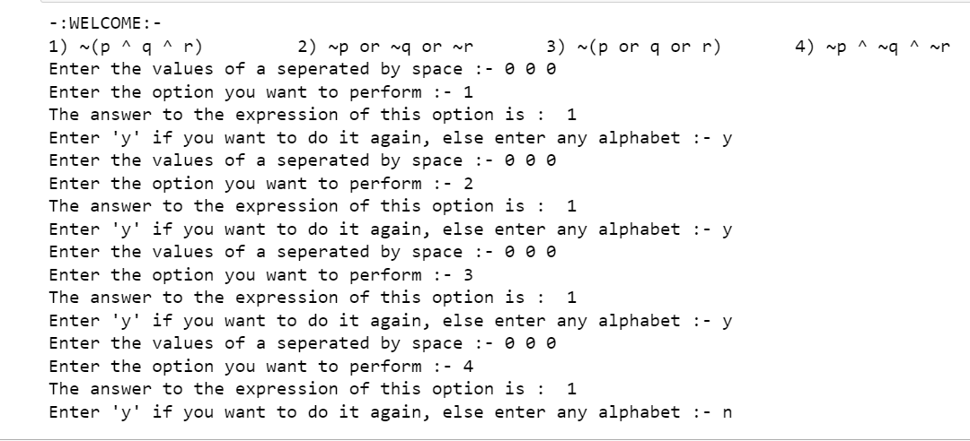
OUTPUT :

